Slide 1
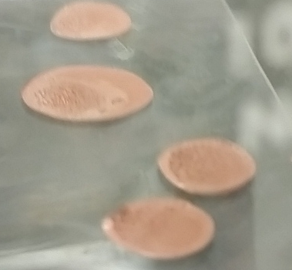
Drop on Demand Printing of Reactive Copper Inks: Resistivity and Morphology
Anoosha Murella, Materials science/engineering
Mentor: dr. owen hildreth

Slide 2
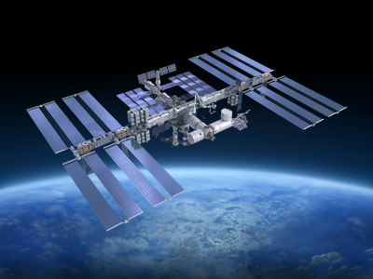
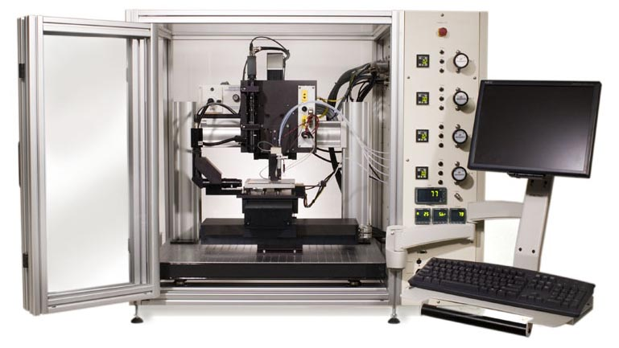
Motivation
Rise of additive manufacturing (AM)
Metallic powders are sintered together
Combustible and require high temperatures
Drop-on-Demand printing more accessible
Notes:
So as many of you know.. AM techniques on rise for last few decades
Most technologies that deal with metals involve powder particles
Unfortunately, not a process
For instance, NASA has eventual goals to print
Metallic inks loaded into compatible printer
Script files written/loaded to print different patterns and geometries layer-by-layer as per user’s specifications

Slide 3
Notes:
Typically, nanoparticle solutions of desire metal prep/printed, capping agent prev agglom
Solutions by nature particle-based suspension; require further post-processing
Ending prints extremely porous result in poor electrical/mechanical prop
In the Hildreth lab take diff approach

Slide 4
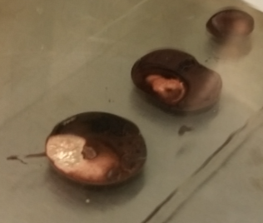
Making Solutions + Pipetting
Partially oxidized copper
Argon container
Copper Solution

Slide 5
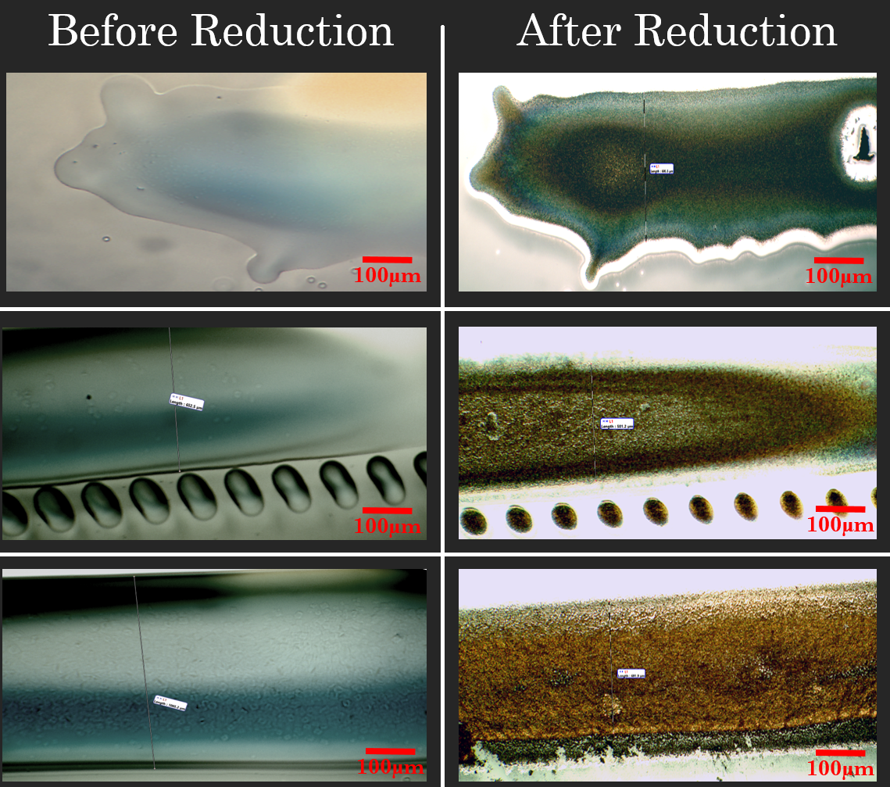
Delayed Reduction Printing
Notes:
Line 3 (0.1 mm 10 layers)
Line 8 (0.2 mm 20 layers)
Line 9 (0.2 mm 50 layers)

Slide 6
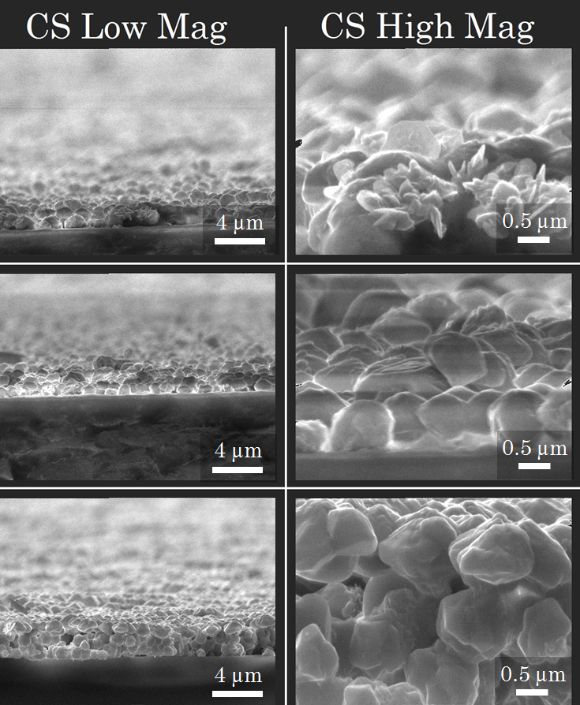
Morphology

Slide 7
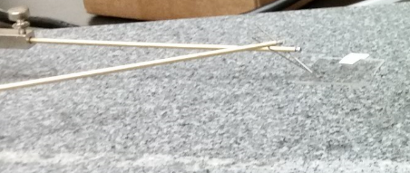
Resistance
7 mm squares before/after reduction
Two-Point Probe
Notes:
3.15e-4Ωm was average resistivity …. 1.68E-8 Ωm

Slide 8
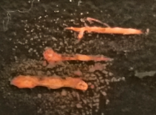
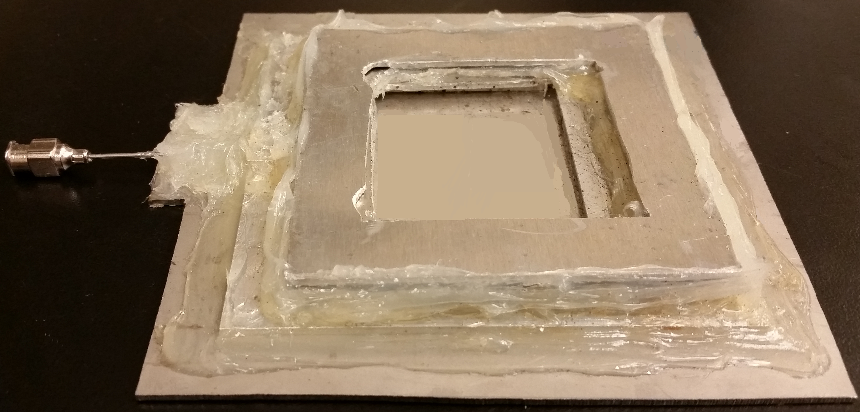
In-Situ Printing
5 layers; 5 mm lines
Argon Shield

Slide 9
Morphology
SEM Images of printed lines and squares, varying the # of layers

Slide 10
Resistance
1:1 IPA, 10 layers
1 drop/burst
1:2 IPA, 5 layers each
10 drops/burst
1:2 IPA, 3 layers
1 drop/burst
Notes:
3.13e-4Ωm vs. 1.68E-8 ohm*m

Slide 11
Acknowledgements
PI: Dr. Owen Hildreth
Lab Members
- Avinash Mamidanna
- Christopher Lefky
- Galen Arnold
- Yiwen Huang
Funding Sources
ASU/NASA Space Grant
Science Foundation Arizona

Slide 12
Questions?

